Slide 1
Programmable interrupt controller 8259
Md. Fazle Rabbi
ID:16CSE057

Slide 2
Contents
Introduction
Block Diagram of 8259 PIC
Details on Block of 8259 PIC
PIN Diagram of 8259

Slide 3
Introduction
8259 is a programmable interrupt controller(PIC) is a tool for managing the interrupt requests
8259 combines the multi interrupt input sources into a single interrupt output.
It has Internal priority resolver which can be programmed into fixed priority mode and rotating priority mode.
It is available as a separate IC

Slide 4
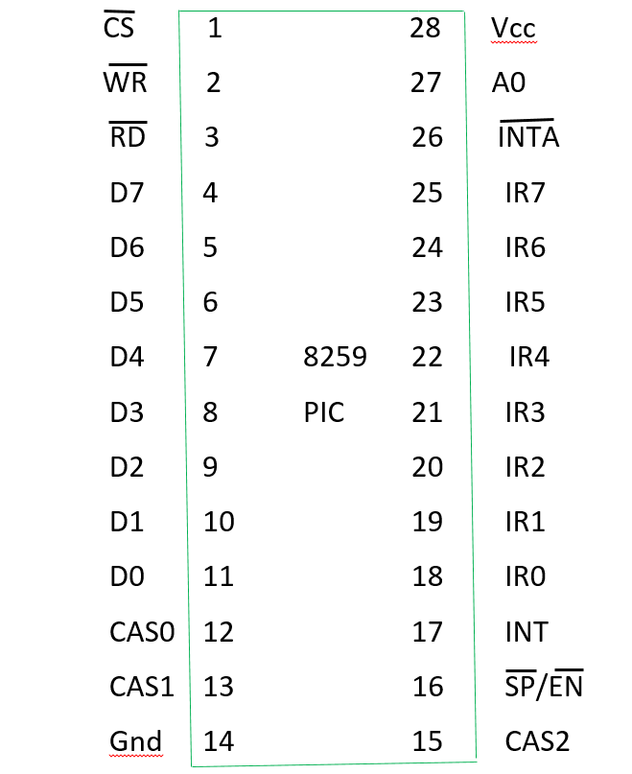
PIN Diagram of 8259

Slide 5
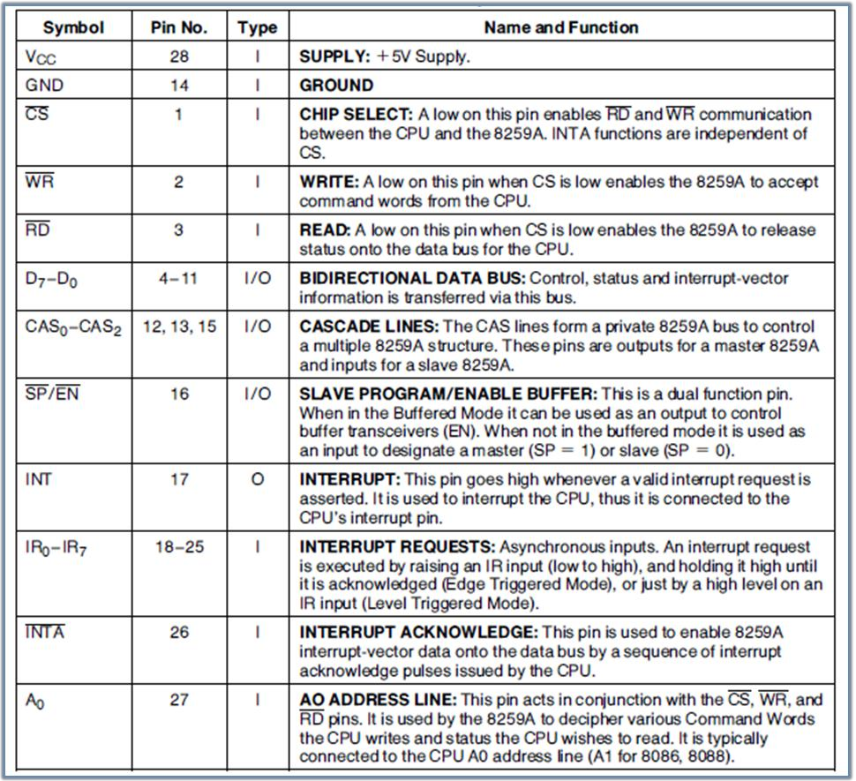
PIN Diagram of 8259

Slide 6
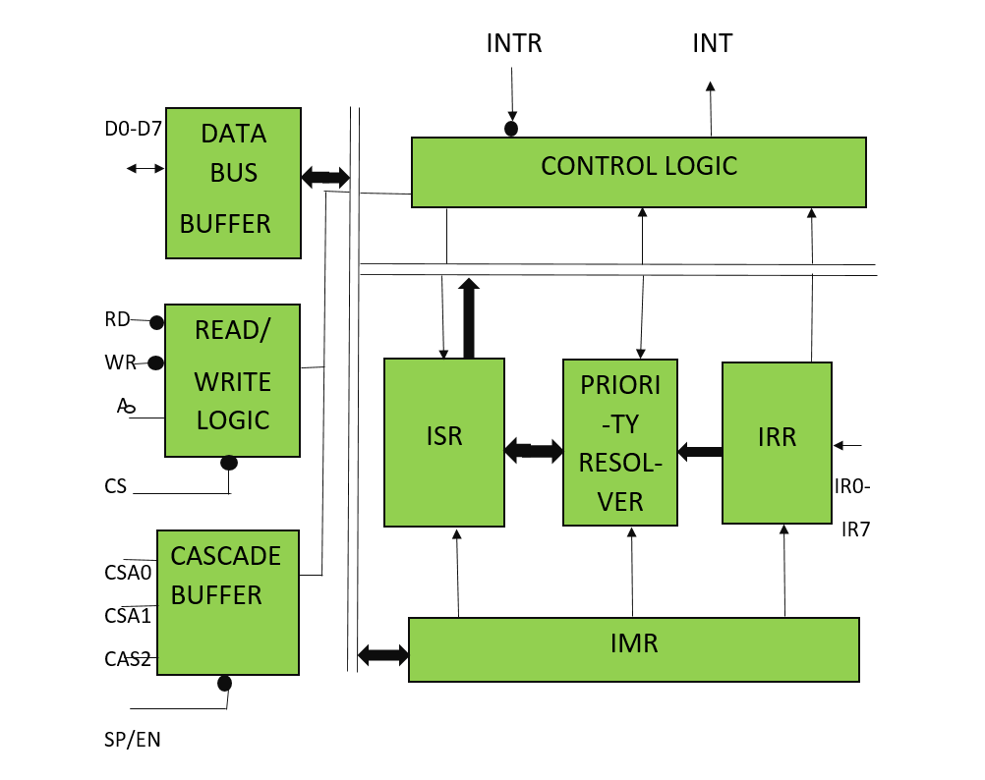
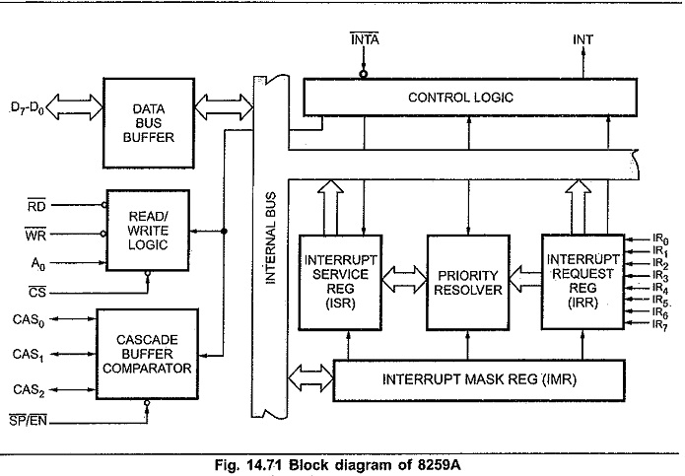
Block Diagram of 8259 PIC

Slide 7
Data bus buffer:
•This, bidirectional 8-bit buffer is used to interface the 8259 to the
system data bus.
•Control words and status information from the microprocessor to PIC
and from PIC to microprocessor respectively, are transferred .
•The processor sends control word to data bus buffer through D0-D7.
•The processor read status word from data bus buffer through D0-D7
•Also, after selection of Interrupt by 8259 microprocessor, it transfer
the op-code of the selected Interrupt and address of the Interrupt
service sub routine to the other connected microprocessor.

Slide 8
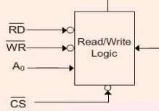
Pins Connected with Read/Write & Control Logic
• RD, WR, CS and A0 are the control signals used in Read/Write and Control Logic.
•The processor uses the RD (low), WR (low) and A0 to read or write 8259.
• A LOW on WR input enables the CPU to write control words
• A LOW on RD input enables the 8259A to send the status of the Interrupt Request Register (IRR), In Service Register (ISR), the Interrupt Mask Register (IMR), or the Interrupt level onto the Data Bus.
•A0 input signal is used in conjunction with WR and RD signals to write commands into the various command registers, as well as reading the various status registers of the chip. This line can be tied directly to one of the address lines

Slide 9
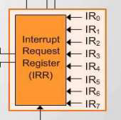
Interrupt Request Register (IRR):
•This block accepts and stores the actual interrupt requests from external interrupting devices on IR0 –IR7 lines.
•Interrupt request register (IRR) stores all the incoming interrupt inputs that are requesting service.
• It is an 8-bit register – one bit for each interrupt request.
• Basically, it keeps track of which interrupt inputs are asking for service and also stores the pending interrupt requests.
•If an interrupt input is unmasked, and has an interrupt signal on it, then the corresponding bit in the IRR will be set.

Slide 10
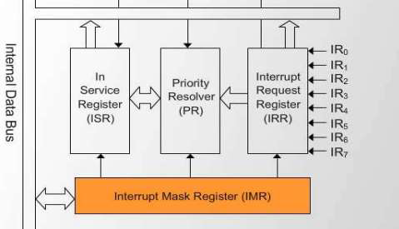
Interrupt Mask Register (IMR):
• This logic block masks interrupt lines based on programming by the processor and prevents masked interrupt lines from interrupting the processor.
• The IMR is used to disable (Mask) or enable (Unmask) individual interrupt request inputs.
• This is also an 8-bit register. Each bit in this register corresponds to the interrupt input with the same number.
• The IMR operates on the IRR. Masking of higher priority input will not affect the interrupt request lines of lower priority.
• To unmask any interrupt the corresponding bit is set ‘0’

Slide 11
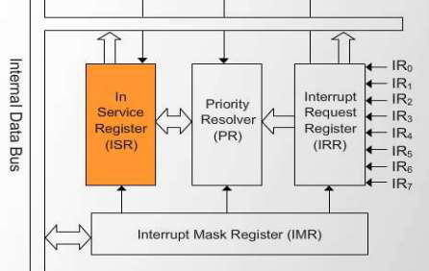
In-service Register (ISR):
• The in-service register keeps track of which interrupt inputs are currently being serviced.
• For each input that is currently being serviced the corresponding bit of in-service register (ISR) will be set.
• Thus, more than one bit of ISR will be set indicating the number of interrupts being serviced.
• Each of these 3-registers can be read as status register.

Slide 12
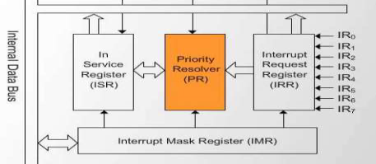
Priority Resolver:
• This logic block determines the priorities of the incoming interrupts set in the IRR.
• It takes the information from IRR, IMR and ISR to determine whether the new interrupt request is having highest priority or not.
• If the new interrupt request is having the highest priority, it is selected and processed.
• The corresponding bit of ISR will be set during interrupt acknowledge machine cycle

Slide 13
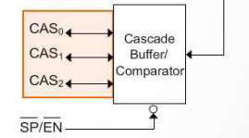
Cascade Buffer/Comparator:
• This logic allows for cascading multiple 8259 controllers in a Master/ Slave configuration.
• This function block stores and compares the IDs of all 8259A’s in the system.
• The associated 3-I/O lines (CAS2-CAS0) are outputs when 8259A is used as a master and are inputs when 8259 is used as a slave.
• As a master, the 8259A sends the ID of the interrupting slave device onto the CAS2-0 lines.
• The slave 8259’s compare this ID with their own programmed ID.
• Thus selected 8259 will send its pre-programmed subroutine address on to the data

Slide 14
THE END

